Slide 1
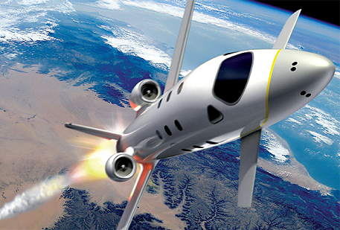

FDIR Spacecraft fault protection system
Project 1
Problem understanding &
UI design
Euro Team
Alauzet Pierre, Ahvenniemi Mikko,
Colin Julien, Starck Benoit
CS554 - Design for Software & Systems

Slide 2
Table of Contents
Problem understanding
Functional requirements (use-case model)
Non-functional requirements
Usability analysis & design

Slide 3
1. Problem understanding
Business purpose & problem frames
Problem understanding
Functional requirements (use-case model)
Non-functional requirements
Usability analysis & design

Slide 4
Business purpose & requirements
Problem understanding
Functional Requirements
Non-Functional Requirements
Usability Analysis & Design
Fault Detection, Isolation and Recovery (FDIR) system is monitoring systems for spacecraft.
FDIR
Guarantee the completion of any time critical activities
Provide manual control
Display information continuously
Collect data to data storage
Locate the fault
Store irresolvable conditions in reports
Automatic recovery to failure
Keep the control with safety, observability & commandability

Slide 5
Problem frames
Problem understanding
Functional Requirements
Non-Functional Requirements
Usability Analysis & Design
Context Diagram :
Crew
Ground Control
Systems
FDIR
Report
Information Display
FDIR Storage System

Slide 6
Problem frames (cont.)
Problem understanding
Functional Requirements
Non-Functional Requirements
Usability Analysis & Design
Problem diagram 1/2: Display information continuously
Information display
a
d
FDIR
Display information
c
b
Systems
c: Systems! {send value/no value}
b: Systems!{functionnal/not funct. proper./broken}
d: FDIR! {display in tol/out-of-tol/no resp}
a: Information display!{console}
Display problem frame

Slide 7
Problem frames (cont.)
Problem understanding
Functional Requirements
Non-Functional Requirements
Usability Analysis & Design
Problem diagram 2/2: Information retrieval
FDIR Storage System
a
c
FDIR
Retrieve information
b
Crew/ Ground Control
d
c:FDIR! {query}
FDIR SS! {return data}
a: FDIR SS!{status data}
b:Crew!{search}
FDIR!{display}
d: Crew!{search}
Commanded behaviour problem frame

Slide 8
Problem frames (cont.)
Problem understanding
Functional Requirements
Non-Functional Requirements
Usability Analysis & Design
Conclusion:
New aspects of requirements were emphasized using problem frames.
Necessity of:
Clearly defining which domains interact with the machine
Considering both data storage, processing and display
Considering errors and exceptions in interactions
Notes:
Problem frames technique provides patterns that allows us to identify each decomposed problem as a singular problem belonging to a standardized type

Slide 9
2. Functional requirements
Use-case & sequences diagrams
Problem understanding
Functional requirements (use-case model)
Non-functional requirements
Usability analysis & design

Slide 10
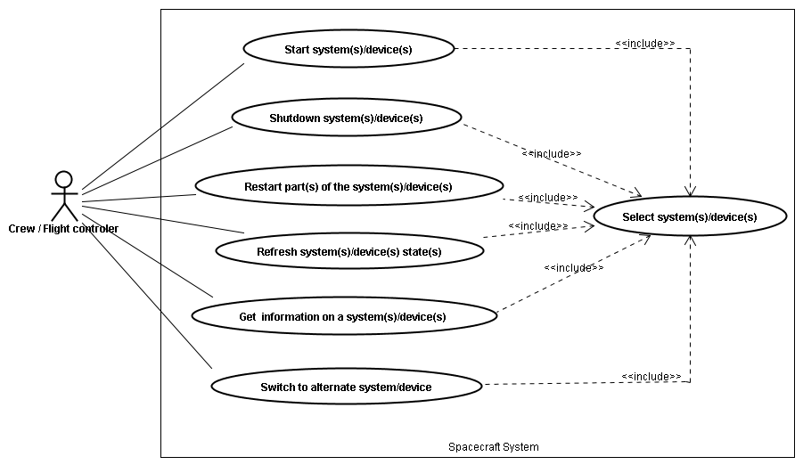
Use case diagram
Problem understanding
Functional Requirements
Non-Functional Requirements
Usability Analysis & Design

Slide 11
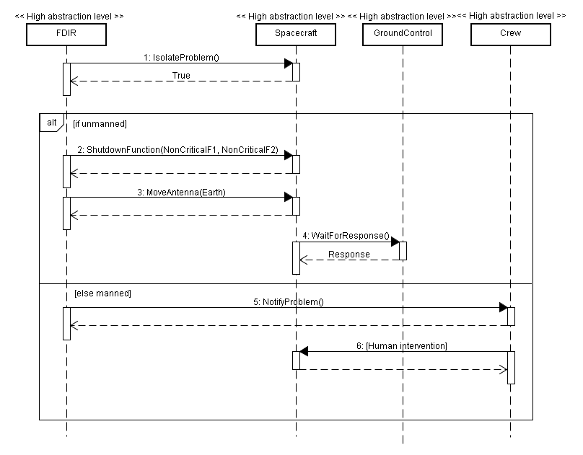
Sequence diagrams
Problem understanding
Functional Requirements
Non-Functional Requirements
Usability Analysis & Design
Safe response in case of hazardous conditions :

Slide 13
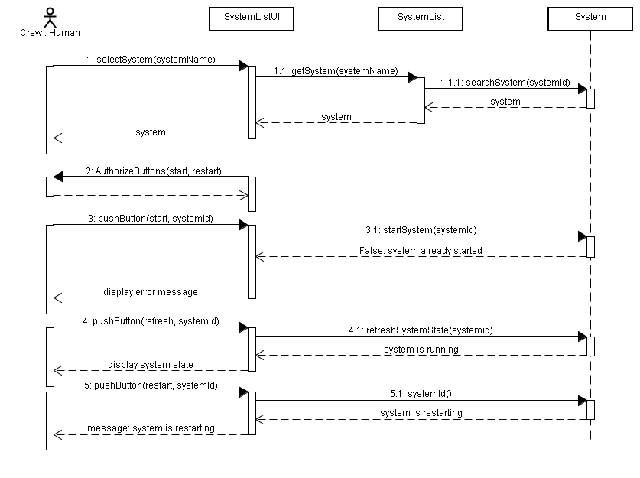
Sequence diagrams (cont.)
Problem understanding
Functional Requirements
Non-Functional Requirements
Usability Analysis & Design
Start system, restart system & refresh system state :

Slide 15
3. Non-functional requirements
Identified & improvised quality attributes
Problem understanding
Functional requirements (use-case model)
Non-functional requirements
Usability analysis & design

Slide 16
Identified attributes
Problem understanding
Functional Requirements
Non-Functional Requirements
Usability Analysis & Design

Slide 17
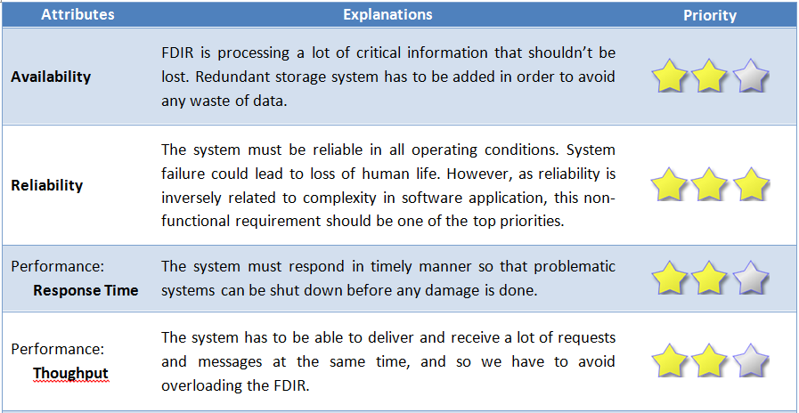
Improvised attributes
Problem understanding
Functional Requirements
Non-Functional Requirements
Usability Analysis & Design

Slide 18
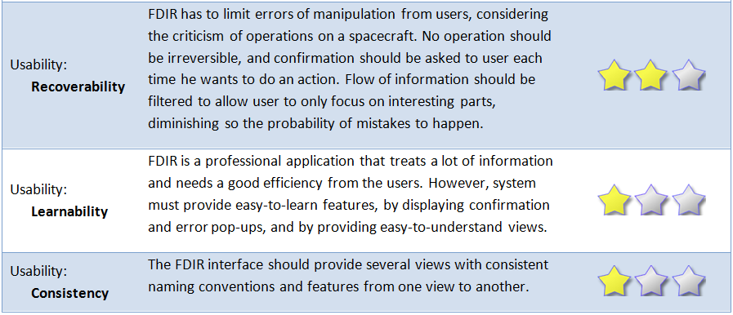
Improvised attributes (cont.)
Problem understanding
Functional Requirements
Non-Functional Requirements
Usability Analysis & Design

Slide 19
4. Usability analysis & design
Prototypes & usability scenarios discussions
Problem understanding
Functional requirements (use-case model)
Non-functional requirements
Usability analysis & design

Slide 20
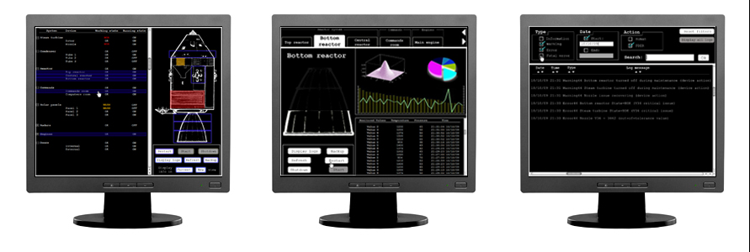
User interface design
Problem understanding
Functional Requirements
Non-Functional Requirements
Usability Analysis & Design
Screen 1
System List
Screen 2
System Information
Screen 3
Logs

Slide 21
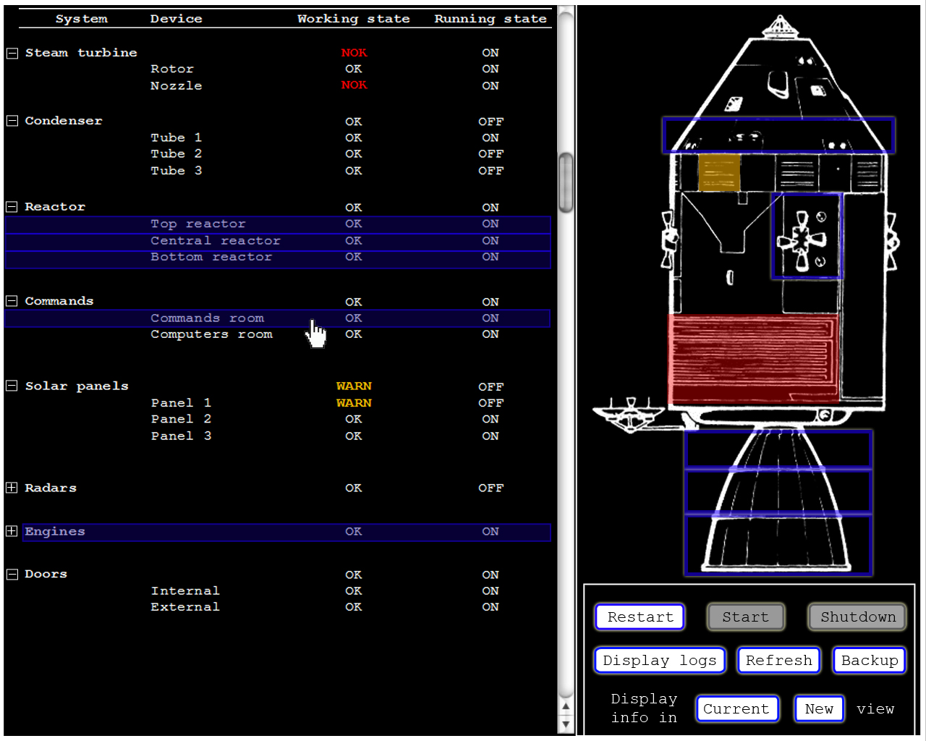

Slide 22
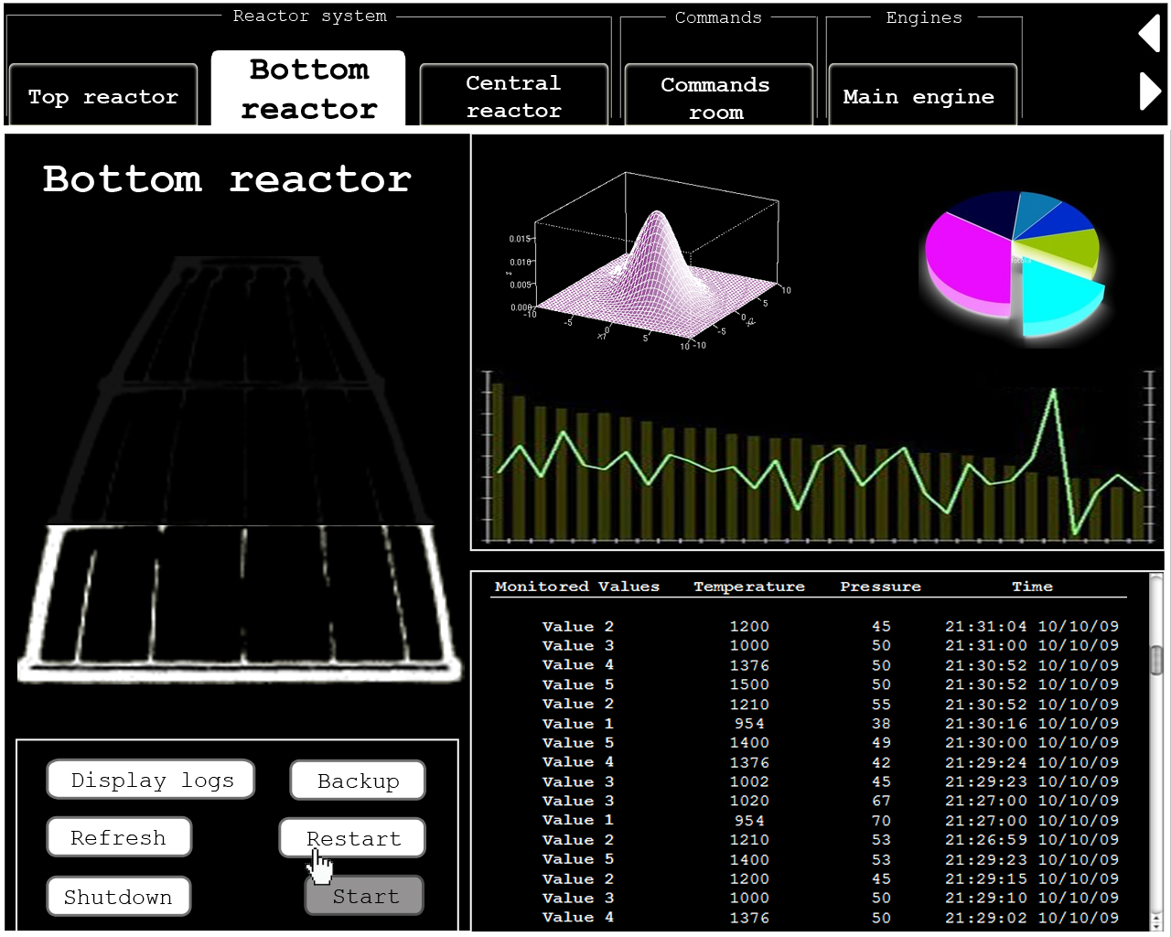

Slide 23
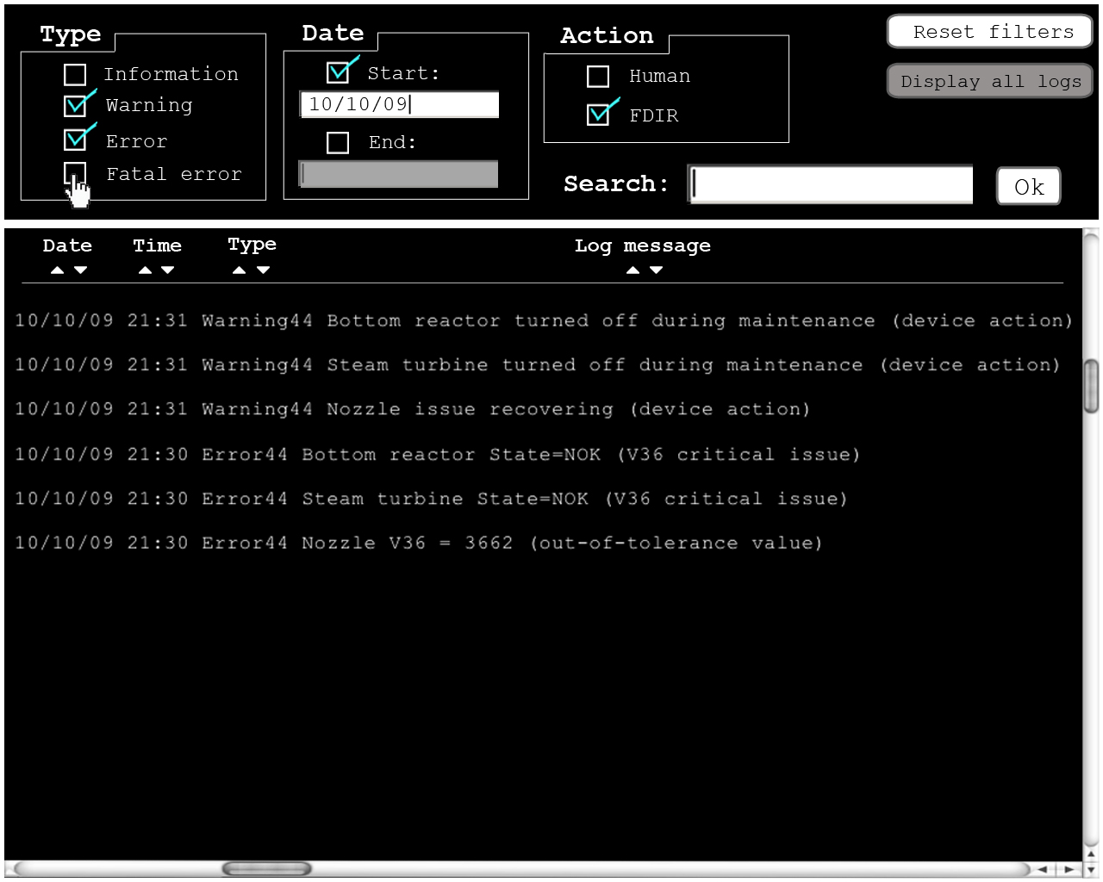

Slide 24
Usability scenarios discussions
Problem understanding
Functional Requirements
Non-Functional Requirements
Usability Analysis & Design
24 Views has to be consistent from one to another
25 Modification in one screen affect the others
15 Concurrent activities
16 Navigation within a single view
26 Displaying in different views & ways
03 Canceling actions
19 Display expected duration of any action

Slide 25
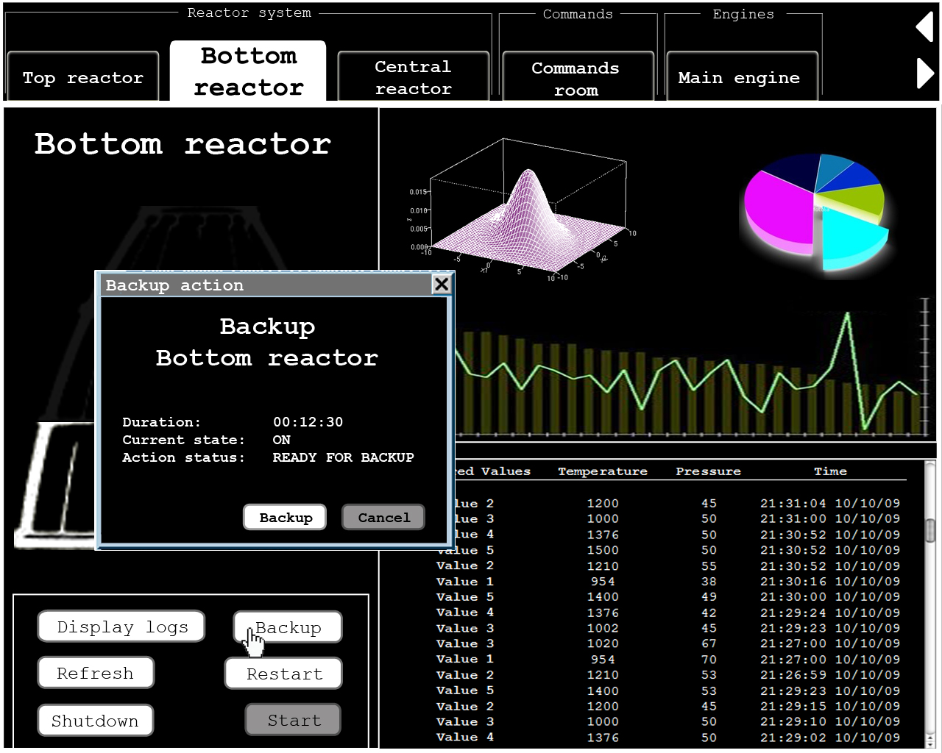

Slide 26
conclusion
UML design
Problem frames
Solutions to bring to system’s requirements
Understand the underlying problems before considering any specification
Usability
Measure the quality of interaction

Slide 27
FDIR Spacecraft fault protection system
Project 1
Problem understanding &
UI design
Euro Team
Alauzet Pierre, Ahvenniemi Mikko,
Colin Julien, Starck Benoit
CS554 - Design for Software & Systems

Slide 28
references
[Eas98] Steve Easterbrook, and et al., Experiences Using Lightweight Formal Methods for Requirements Modeling” IEEE Transactions on Software Engineering, Vol. 24, No. 1, January 1998.
[Jac05] Michael Jackson, Problem frames and software engineering, Information and Software Technology, Special Issue: 1st Int Workshop on Advances and Applications of Problem Frames, K. Cox, et al. eds, Vol. 47 No. 14, pp. 903-912, Nov. 2005.
http://www.bredemeyer.com/pdf_files/NonFunctReq.PDF, about non-function requirements

